Slide 1
Climate Resilient Infrastructure

Slide 2
Let’s hear what our Engineer,Sammy and Mayor planning about Climate Resillience Infrastructure…

Slide 3
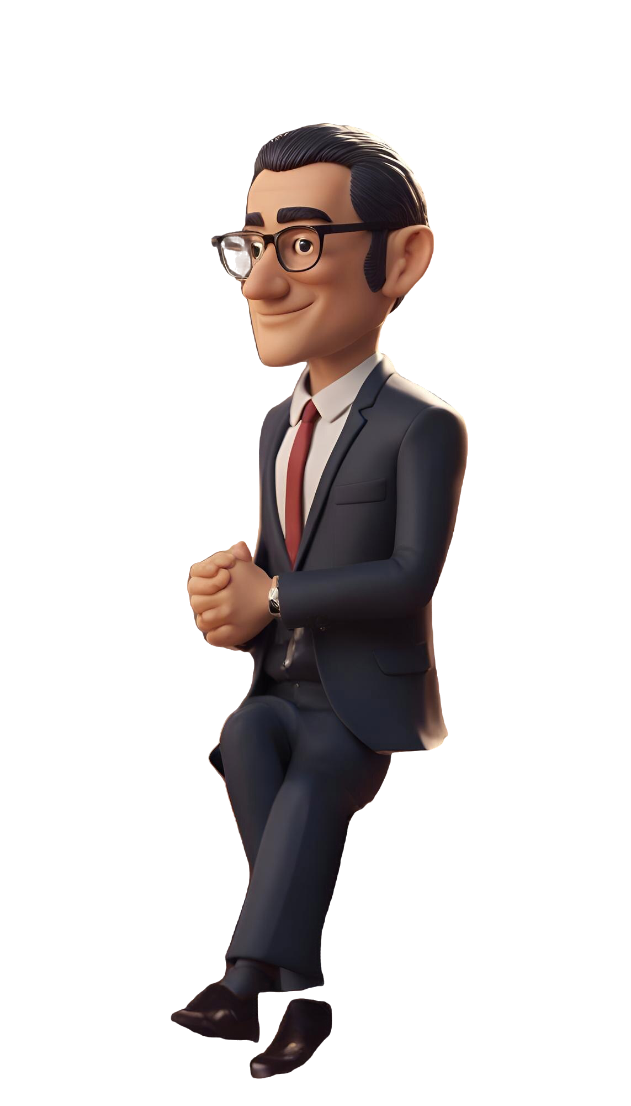
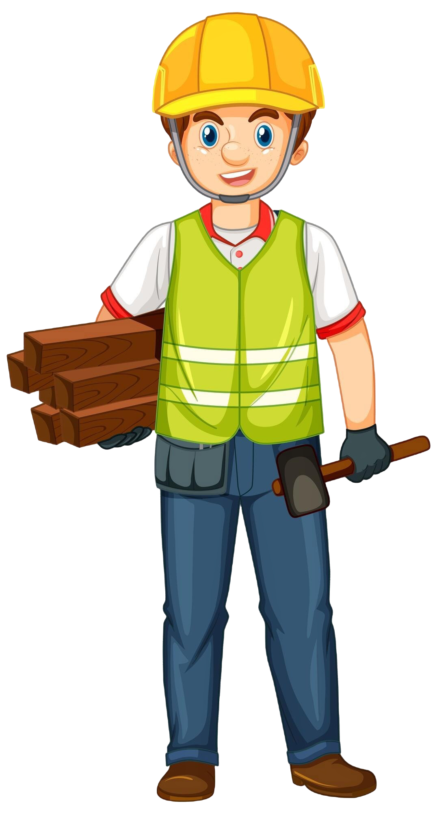

It’s about building our town to withstand climate change, like stronger roads and buildings that can handle storms.
Exactly! We’ll use better materials, create green spaces to absorb rain, and build seawalls to protect against flooding.
What’s this talk about climate-resilient infrastructure?

Slide 4
We’ll make it safer too, with plants that help manage water and provide shade!
That sounds great! What about the playground?
Exactly!

Slide 5
Awesome! I can’t wait to see our town become stronger!

Slide 6
Designing climate-resilient infrastructure is not just about building for today but ensuring a thriving tomorrow. By envisioning future-proof cities, we create spaces that adapt, endure, and flourish, embodying our commitment to sustainability and the well-being of generations yet to come….

